Slide 1
AUSTRALIA
Ania Walwicz

Slide 2
Ania Walwicz
Ania Walwicz (born 1951) is a contemporary Australian poet and prose writer, and visual artist.
Ania Walwicz spent her childhood in Poland, coming to Australia in 1963 where she attended the Victorian College of the Arts (VCA) in Melbourne.
Her writing tends toward an impressionistic, stream of consciousness exploration of inner states. It also exploits 'appropriative' or 'sampling' techniques of production.
She has performed her work in France, Japan and Switzerland and currently teaches creative writing at RMIT in Melbourne.

Slide 3
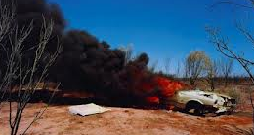

Slide 4
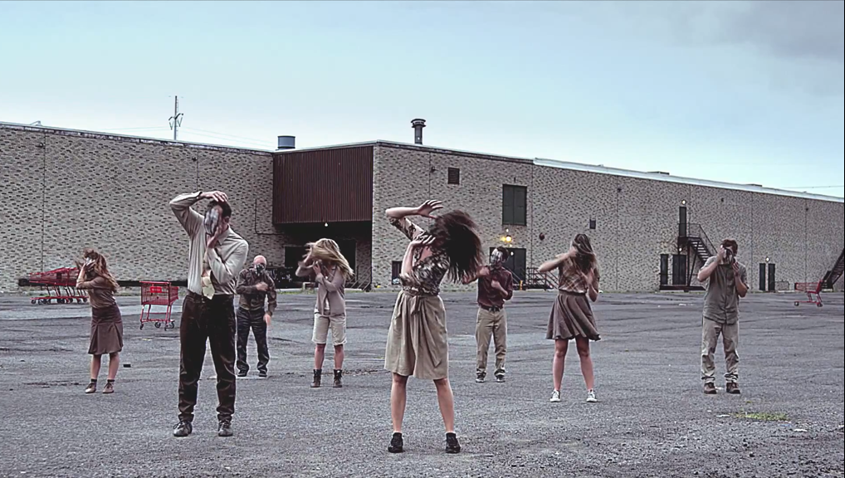

Slide 5
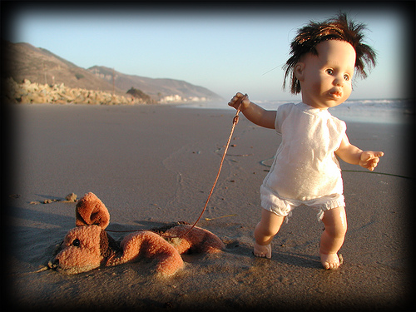

Slide 6
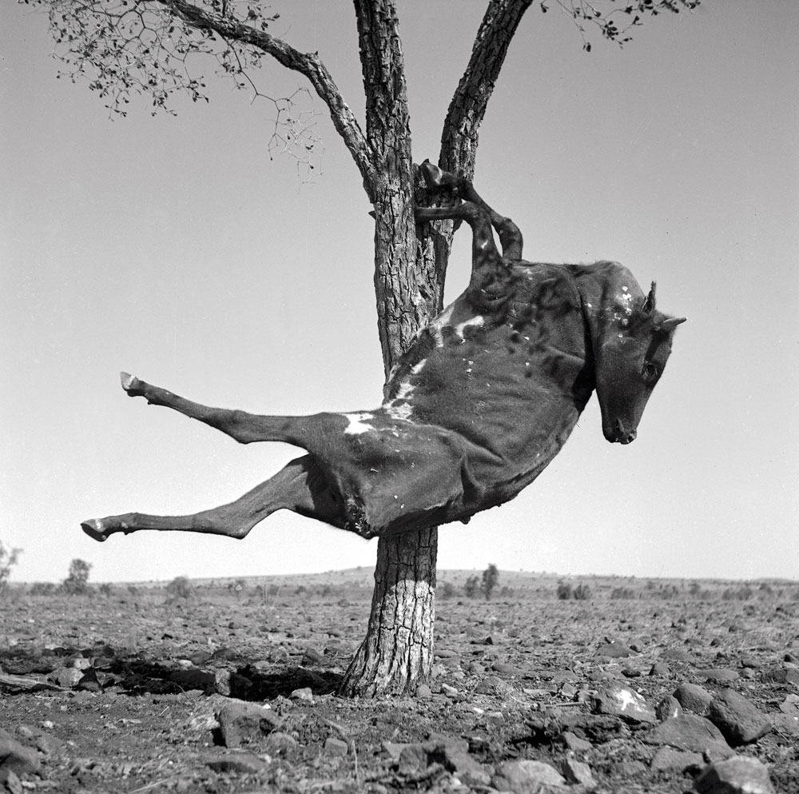

Slide 7
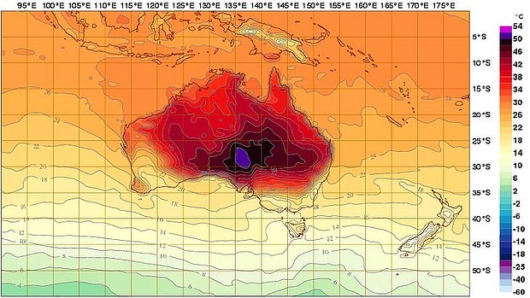

Slide 9
http://www.youtube.com/watch?v=EIH7w0jx8NE

Slide 11
Poor grammar mocks how Australians think of immigrants
2nd person imperative language aims critique at Australians
The wide open spaces hold nothing for her
Repetition is important for driving home the message
You big ugly.
You too empty.
You desert with your nothing nothing nothing.
You scorched suntanned.
Old too quickly.
Acres of suburbs watching the telly.
You bore me.
Freckle silly children.
You nothing much.
With your big sea.
Beach beach beach.
The sun is dangerous
‘S’ Alliteration
Critique of large boring suburbs
Completely over the preoccupation with the beach
Repetition

Slide 12
First person imperative dismisses the iconic imagery of Australia
Criticises the suburban dream and consumer culture
I´ve seen enough already.
You Dumb dirty city with bar stools.
You´re ugly.
You silly shoppingtown.
You copy.
You too far everywhere.
You laugh at me.
When I came this woman gave me a box of biscuits.
You try to be friendly but you´re not very friendly.
You never ask me to your house.
You insult me.
You don´t know how to be with me.
Alliteration of ‘D’ and ‘S’ draws the readers attention to the critique of suburban consumer culture
Claims the idea that Australians are a friendly lot is just not true.
Again; second person imperative aims criticism directly at Australians

Slide 13
Australian landscape is quite boring
Humorous Repetition
Road road tree tree.
I came from crowded and many.
I came from rich.
You have nothing to offer.
You´re poor and spread thin.
You big.
So what.
I´m small.
It´s what´s in.
Repetition of ‘I’ is juxtaposed against the repetition of ‘you’ to reinforce the superiority of European cultural heritage
Comparing European culture with Australian. Suggests that Australia is culturally backward
Imperative dismisses Australian claims that big is beautiful

Slide 14
Suburban Australia is boring and has nothing to offer culturally.
You silent on Sunday.
Nobody on your streets.
You dead at night.
You go to sleep too early.
You don´t excite me.
You scare me with your hopeless.
Asleep when you walk.
Too hot to think.
You big awful.
You don´t match me.
Alliteration of ‘S’ sound. A hissing critique of Australian culture
Suggests that Australians are unthinking and intellectually stunted compared to Europeans
Again; second person imperative (‘you’) aims criticism directly at Australians

Slide 15
The plain nothingness of the landscape makes Australians lazy
You burnt out.
You too big sky.
You make me a dot in the nowhere.
You laugh with your big healthy.
You want everyone to be the same.
You´re dumb.
You do like anybody else.
You engaged Doreen.
You big cow.
You average average.
Conformity-
claims that Australia lacks innovation and original thinking.
Humorous repetition emphasises the point that Australians love conformity

Slide 16
Cold day at school playing around at lunchtime.
Running around for nothing.
You never accept me.
For your own.
You always ask me where I´m from.
You always ask me.
You tell me I look strange.
Different.
You don´t adopt me.
You laugh at the way I speak.
You think you´re better than me.
You don´t like me.
Criticises Australian racism. Contradicts multicultural view of Australia
Repetition stresses the frustration
Repetition of ‘me’ makes the rejection very personal

Slide 17
Australians are isolated physically and intellectually
Repetition of the upper case I in ‘interest’ and ‘idiot’ emphasises the sense of ignorance
You don´t have any Interest in another country.
Idiot centre of your own self.
You think the rest of the world walks around without shoes or electric light.
You don´t go anywhere.
You stay at home.
You like one another.
Alliteration of ‘s’ sound. I just love this line. Highlights the self centeredness of Australian thinking.
Australians are ignorant of the wider world

Slide 18
Criticises the Australian culture of drinking alcohol
You go crazy on Saturday night.
You get drunk.
You don´t like me and you don´t like women.
You put your arm around men in bars.
You´re rough.
I can´t speak to you.
You burly burly.
You´re just silly to me.
You big man.
Suggests that Australian men cannot relate to women. Macho ’Mateship’ borders on the homoerotic
Repetition stresses criticism of ‘macho’ culture

Slide 19
Paradox emphasises the juxtaposition between our wealth and actual status
Despite Australian wealth, we are socially, intellectually and culturally backward
Poor with all your money.
You ugly furniture.
You ugly house.
Relaxed in your summer stupor: All year.
Never fully awake.
Dull at school.
Repetition of ‘ugly’ further stresses our backwardness
Critique of the ‘She’ll be right’ attitude.
Stupor: an acute lack of mental alertness

Slide 20
Wait for other people to tell you what to do.
Follow the leader.
Can´t imagine.
Work horse.
Thick legs.
You go to work in the morning.
You shiver on a tram
Perhaps a political criticism of Australian political leaders during the post WW2 period.
Metaphor: Australians work unthinking for others

